Slide 1

Shri Vishnu Engineering College for Women::Bhimavaram (Autonomous)
Campus Centric Second Hand Exchange
IV B.Tech II Sem Project power point presentation
In
Computer Science and Engineering
By
1. Mohammed Afreen - 18B01A05G9
2. Sunnapuram Sai Durga – 18B01A05D7
3. Veluguri Lakshmi Sindhu - 18B01A05E6
4. Bathula Gowthami - 18B01A05F6
5. Tadikonda Tejaswi - 18B01A05D8
Under the guidance of
Mr. M. Ramesh Babu, M.Tech(PhD)
Assistant Professor
REVIEW NO: 2
Date: 22 Mar 2022
Department of Computer Science and Engineering Slide No:1

Slide 2
Contents
Problem Statement
UML Diagrams
(Use case, Class, Activity, Sequence, Collaboration)
Functionalities
Technical Skills for system development
Design Comparisons
Implementation
Preliminary Results
Department of Computer Science and Engineering Slide No: 2

Slide 3
Problem Description
According to situations around that we are advocating green civilization nowadays, saving resources as much as we can should be an important issue.
As we are new generation students, we enjoy great convenience that sophisticated technology brings to us. Using it to deal with realistic problems is what we ought to do.
That is why this project designs and implements for the campus a second-hand trading website; offering a platform for students trading old items easily.
There are many students who cannot afford the new products, so they can have the opportunity to buy old items.
Department of Computer Science and Engineering Slide No: 3

Slide 4
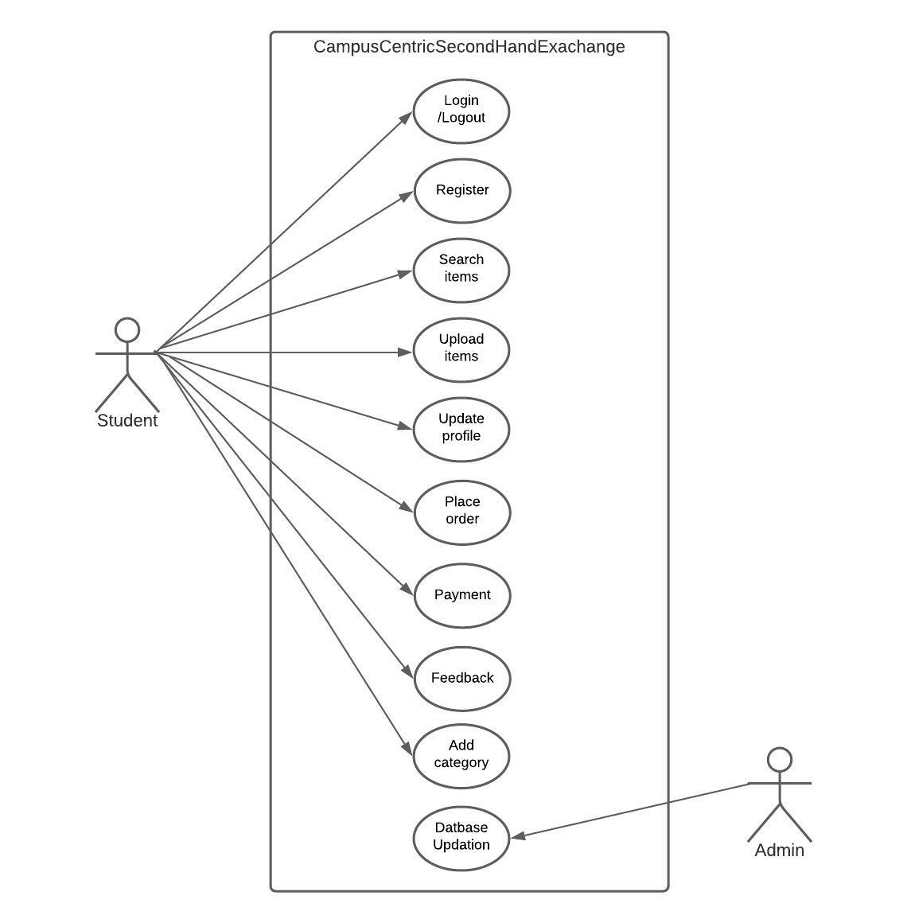
Use Case
Department of Computer Science and Engineering Slide No: 4

Slide 5
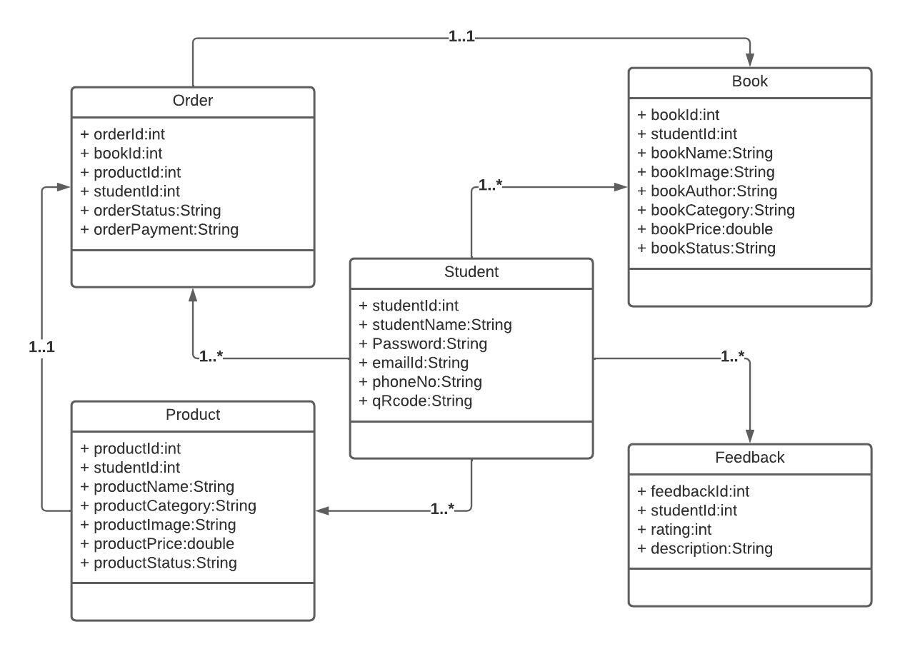
Class Diagram
Department of Computer Science and Engineering Slide No: 5

Slide 6
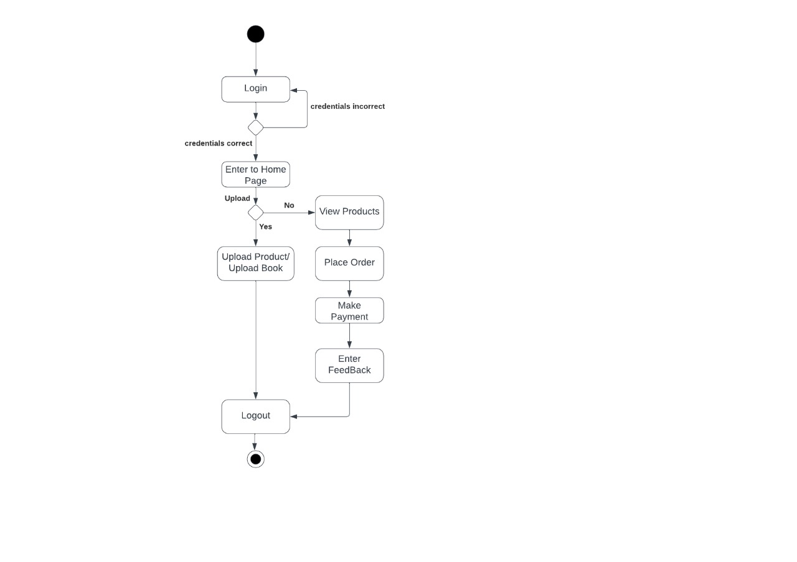
Activity Diagram
Department of Computer Science and Engineering Slide No: 6

Slide 7
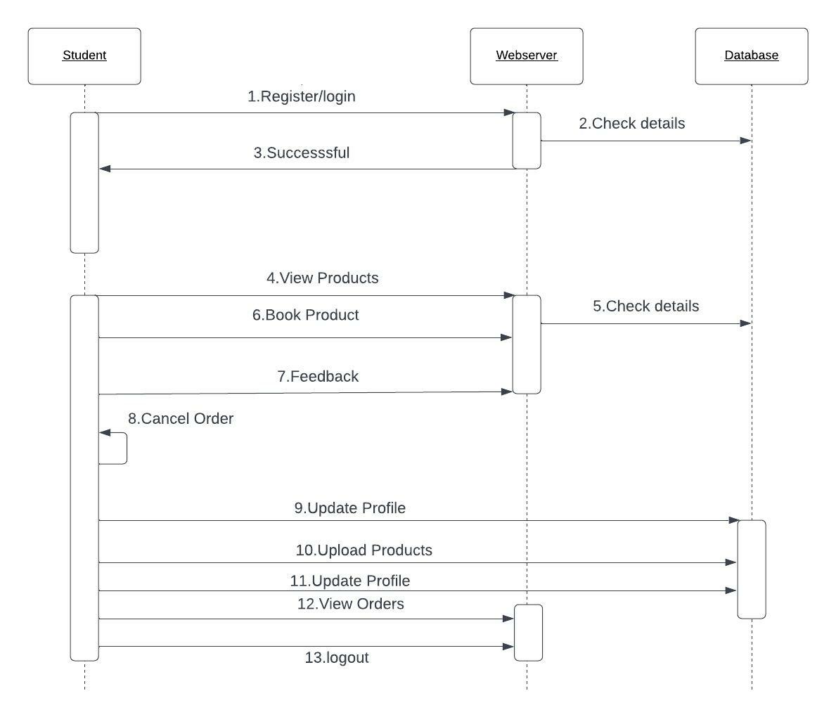
Sequence Diagram
Department of Computer Science and Engineering Slide No: 7

Slide 8
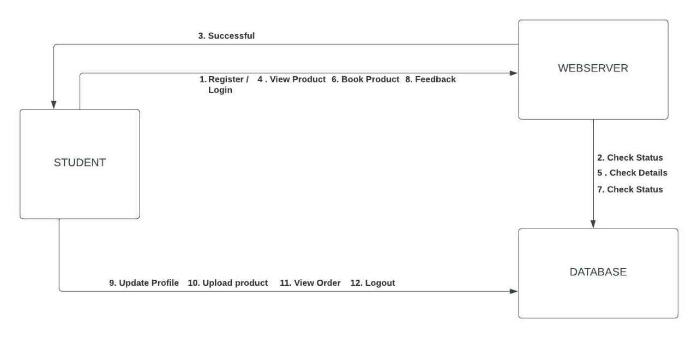
Collaboration Diagram
Department of Computer Science and Engineering Slide No: 8

Slide 9
Functionalities
Registration
User Login
Search Product
Update Profile
Place Order
Share Feedback
Department of Computer Science and Engineering Slide No: 9

Slide 10
Technical Skills For System Development
Angular using TypeScript
HTML
CSS
Bootstrap
MySQL
Java
REST API
Department of Computer Science and Engineering Slide No: 10

Slide 11
Design Comparisons
Problems in Existing system :
Existing websites do have fundamental customers.
Since these platforms are open to the whole citizens, we cannot easily find what we need for campus.
Department of Computer Science and Engineering Slide No: 11

Slide 12
Design Comparisons
Proposed System :
A trade website which just focuses on a single university.
This website is a on campus massive potential market of second-handing trading to save money and also to help in protecting the environment.
The students usually generate a great deal of spare items such as books, drafters, chairs, etc can upload their items in this website and sell them.
Department of Computer Science and Engineering Slide No: 12

Slide 13
Implementation
Done | Yet to be done
Register | Place order
Login / Logout | Profile update
Upload Product | Feedback form
View Products | View Orders
View Uploads | Search
Department of Computer Science and Engineering Slide No: 13

Slide 14
Preliminary Results
Implementation – website link
CampusCentricSecondHandExchange
Department of Computer Science and Engineering Slide No: 14

Slide 15
THANK YOU
Department of Computer Science and Engineering Slide No: 15

